Slide 1

Software Requirements
Specification

Slide 2
Software Requirements Specification (SRS)
Defines the customer’s requirements in terms of :
  Functional requirements
  Performance requirements
  External interface requirements
  Design constraints
The SRS is the basis of contract between the purchaser and supplier (developer team).

Slide 3
What is not included in an SRS ?
Project requirements
  cost, delivery schedules, staffing, reporting procedures
Design solutions
  partitioning of SW into modules, choosing data structures
Product assurance plans
  Quality Assurance procedures, Configuration Management procedures, Verification & Validation procedures

Slide 4
Functional Requirements
Transformations (inputs, processing, outputs)
Requirements for sequencing and parallelism (dynamic requirements)
Data
  Inputs and Outputs
  Stored data
  Transient data
Exception handling
Nature of function: Mandatory/ Desirable/ Optional / Volatile / Stable

Slide 5
Performance Requirements
Capacity
  no. of simultaneous users, processing requirements for normal and peak loads, static storage capacity, spare capacity
Response time
System priorities for users and functions
System efficiency
Availability
Fault recovery
All these requirements should be stated in measurable terms so that they can be verified.

Slide 6
External Interface Requirements
User interfaces
  eg. if display terminal used, specify required screen formats, menus, report layouts, function keys
Hardware interfaces
  characteristics of the interface between the SW product and HW components of the system
Software interfaces
  Interface between the SW product and other external SW.

Slide 7
Design Constraints
SW design constraints
  standards for design, coding, naming, etc.
  Specific SW to be used example - OS, DBMS, other SW
  use a specific application package
  constraints on program size, main memory, data size etc.
HW design constraints
  specific type of HW to be used, reliability requirements
  HW interfaces
  requirements for spare capacity or spare performance

Slide 8
Design Constraints (contd)
User-interface design constraints
  features of operator/user with details of working environment
  any special features required

Slide 9
Other Requirements
Security
Safety
Environmental
Reusability
Training
...

Slide 10
SRS Standards
ANSI/IEEE SRS Standard 830-1984
BS 6719: 1986
European Space Agency Standards
(ESA PSS-05-0, Jan 1987)
US DoD-Std-7935A
...

Slide 11
Examples of Requirements statements
The data set will contain an end of file character.
The product should have a good human interface.
The program shall never enter an infinite loop.
The output of the program shall usually be given within 10 secs.
The output of a program shall be given within 20secs of event X 60% of the time.
Ambiguous
Non-verifiable
Non-verifiable
Non-verifiable
Verifiable

Slide 12
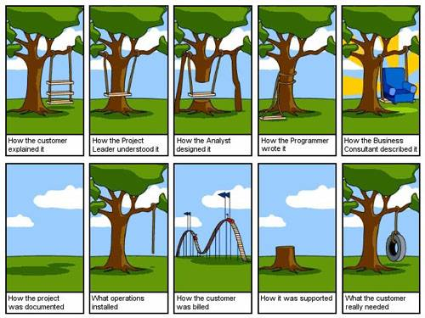

Slide 13
What we have learnt ?

